Slide 1
Course : T7043 – IT Services
Period : February 2018
Network Management
Session 06
D5664 – Dr. Eng. Antoni Wibowo

Slide 2
Network management
Network management refers to the activities, methods, procedures, and tools that pertain to the operation, administration, maintenance, and provisioning of networked systems.^{[1]}
A common way of characterizing network management functions is FCAPS—Fault, Configuration, Accounting, Performance and Security.
Bina Nusantara

Slide 3
Function Network Management
Functions that are performed as part of network management accordingly include controlling, planning, allocating, deploying, coordinating, and monitoring the resources of a network, network planning, frequency allocation, predetermined traffic routing to support load balancing, cryptographic key distribution authorization, configuration management, fault management, security management, performance management, bandwidth management, Route analytics and accounting management.
Bina Nusantara

Slide 4
Agenda
Network Characteristics
Marketplace and Business Benefits
Network Management Service Definition
IT Infrastructure and Service Management
Managed Devices
Management Methods
Network Management Architecture
Network Management Roles
Summary
Bina Nusantara

Slide 5
NETWORK MANAGEMENT
Network Characteristics

Slide 6
Network Characteristics
Networks provide the mechanism for the flow of electrons or photons between endpoints
Comprised of devices such as copper and glass cables, switches, hubs, routers, firewalls, circuits, software, and other network devices
Protocols for securely encapsulating the flows into coherent data packages include SNA, TCP/IP, and Netware
The flows represent voice, video, and data
Bina Nusantara

Slide 7
NETWORK MANAGEMENT
Marketplace and Business Benefits

Slide 8
Marketplace
Insight Research Corporation predicts (US) customer network management to be a $2.5 billion industry in 2005 (http://www.insight-corp.com/reports/self.asp)
Network management software market in Asia generated $175M in 2004 (http://blogs.zdnet.com/ITFacts/index.php?p=8015)
Industry Example - IBM manages for it’s clients 2,400 firewalls, 56,000 routers, and 13,000,000 LAN ports
Bina Nusantara

Slide 9
Business Benefits
Compliance with governmental regulations
  Sarbanes Oxley, state laws, federal children’s online privacy protection act
Add security and business resilience through intrusion detection and thwarting denial of service attacks
Reduce IT costs via automation of tasks
Electronic correlation of network device states provides swifter problem determination and reduction of outage duration
Simplify understanding of extremely complex device relationships through topology methods
Bina Nusantara

Slide 10
NETWORK MANAGEMENT
Network Management Service Definition

Slide 11
Service Definition
Network management is the planning, design, implementation, operation, and optimization of network devices to achieve business goals
Primary network management disciplines include
  Device availability
  Asset and configuration control
  Security
  Capacity and performance
Network management availability includes
  Error detection, filtering, and correlation
  State modification
  Logging and reporting
Bina Nusantara

Slide 12
NETWORK MANAGEMENT
IT Infrastructure and Service Management

Slide 13
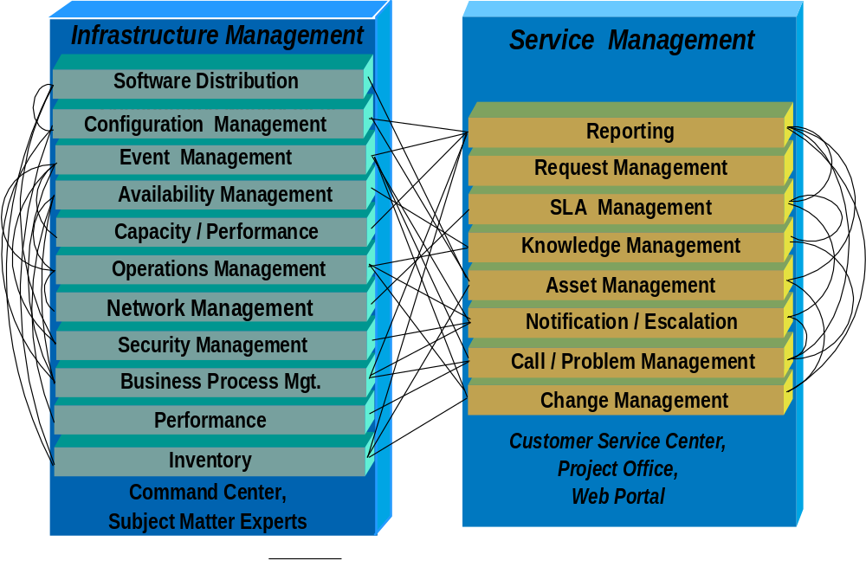
Network Management – and IT Service Management
Bina Nusantara

Slide 14
NETWORK MANAGEMENT
Managed Devices

Slide 15
Managed Devices
Hubs
Routers
Printers
Firewalls
Switches
Fiber Optic panels
Storage area networks
Server network interfaces
Other Local Area Network (LAN) components
Wide Area Network (WAN) circuits
Metropolitan Area Network (MAN) circuits
Bina Nusantara

Slide 16
Managed Devices (cont)
Hygrometers
Telephones
Train switches
Vending machines
Temperature sensors
Door locks and latches
Mobile phone transmitters and receivers
Video surveillance cameras
Automatic teller machines
Fire and smoke detectors
Air conditioners
Perimeter fences
Motion detectors
Bina Nusantara

Slide 17
NETWORK MANAGEMENT
Management Methods

Slide 18
Management Methods
Software and hardware are used to manage many aspects of networks
Simple Network Management Protocol (SNMP) is the primary management protocol for network devices
SNMP uses Traps based on RFCs and MIBs to detect or change the state of network devices
Request for Comment (RFC)
  The RFC editor issues an RFC with a unique, serialized number - http://www.rfc-editor.org/rfc.html
  The RFCs form a continuous history of the standards
  Internet Engineering Task Force (IETF) adopts some of the theory published in RFCs as Internet standards
  RFC standards are not like ANSI or ISO standards
  RFC1611 DNS, RFC1230-802.5 Token Ring, RFC1512-FDDI, RFC2026 – Internet Standards Process V3, Hyper Text Coffee Pot Control Protocol (HTCPCP/1.0) published 4/1/1998
Bina Nusantara

Slide 19
Management Methods (cont)
Management Information Base (MIB)
  database containing information for network management organized as a tree
  MIB variable values are stored in the leaves of the tree
  upper structure of the tree is defined in Requests for Comments (RFC) 1155 and RFC 1213
  internal nodes of the tree represent subdivision by organization or function, each node is unique and consists of a string of node numbers separated by decimals
  MIB numbers are categorized by vendor and device
  Tree has three primary branches: International Telecommunication Union Telecommunication Standardization Sector (ITU-T), International Organization for Standardization (ISO), ISO/ITU-T
  Example: 1.3.6.1.2.1 is iso.org.dod.internet.mgmt.mib
Bina Nusantara

Slide 20
Management Methods (Cont2)
Common Management Information Protocol/Guidelines for the Definition of Managed Objects (CMIP/GDMO)
  ITU network management protocol
  Richer and a better object oriented basis than SNMP
Common Object Request Broker Architecture (CORBA)
  object oriented remote-procedure-call
  less expensive alternative to CMIP/GDMO
Bina Nusantara

Slide 21
Management Methods (Cont3)
Availability management
  Network ping as a heartbeat
  Polling interval vs. management overhead
  State manipulation via SNMP
  Rules base processing – artificial intelligence
  Correlation between states of multiple devices
Network management software
  HP Openview, Tivoli Netview, BMC, MicroMuse Netcool, Microforge Enterprise Server, Solarwinds Orion, Lucent, Sensible Overseer, Fidelia Netvigil, OpenNMS, Javvin, AdRem*
* Product Trademarks and/or Copyrights of respective companies
Bina Nusantara

Slide 22
Management Methods (Cont4)
Correlation
  Network, processors, storage, and applications are inter-dependent
  Multiple support organizations by IT device type
  Outages may manifest as primary, secondary and tertiary device state reports in the management systems
  Automated determination
  Suppression of support dispatch
Logical topology management simplifies the understanding of complex relationships
Bina Nusantara

Slide 23
NETWORK MANAGEMENT
Architecture

Slide 24































































Availability Management Domain
Branch
Locations,
Hubs & Switches
Corporate,
Routers,
Firewalls
Physical Plant
Devices
Device State Information
Command and Control
Device State Information
Branch
Location
Management Systems
Local Area Network
Management
Systems
SNMP Device
Management
Systems
Command, Control, and State
WAN
Provider
Device State Information
Device State Information
Correlation
Enterprise Network
Management
Console
Automated
Notification
Device State Information
e-mail, paging
Operations Center
Human Operators
Receiving Network Device State Conditions for situation management
Enterprise Availability Management
Enterprise Problem and Change Management
Bina Nusantara

Slide 25
Enterprise Availability Management Domain Engineering Schematic
Management Systems
Enterprise
Enterprise
Enterprise
Business
Infrastructure
Systems
Service
View
Management
Management
Management
Rendering
Tivoli
Paging
Engine
Console
Engine
Mainframe
End User
Netfinity
AT&T
AT&T
Bank
Lexmark
Bank
Bank
Servers
Experience
Manager
Markvision
NV/390,
Probe
OS/2, SNA,,
Event Mgt.
Tivoli
Compaq
BMC
Credit Bureau
HP/ITO and
Problem Mgt.
Novell
Lexmark and
Enterprise
Insight
Mainview
SBS, CLA, ILS,
Transfers
Tivoli Enterpirse
Remedy
Managewise
HP Printers
Console
Manager
APS, Internet
Consoles
Regional
LAN and Wan Elements
LAN
MVS/ESA
Server
Desktop Client
Application
AIX S/70 Application
Switches, Hubs, Routers
CPU
MS IE
and Database Server
and Database Server
File Space
MS Excel
Credit
Print
Powerbuilder
VTAM , CICS, DB/2, DL1,
Bureau
Server
LAN Printer
Sybase Client
VSAM, SBS, CLA, ILS
SNA, CICS, Sybase, APS
Server
Farm
Telnet 3270
OS/2
Novell
StarGate Server
SNA
FaxPress
Lotus
Corporate Campus
dbg42
0
Server
Notes
Various Information Sources
Edge Router
Routers,
Premise Router
LAN Hub
Transport
Internet
AT&T WAN
Regional Business Center
Bina Nusantara

Slide 26
Service Interconnections
Possible Infrastructure Service Interconnections with Network Management include:
Event management
Problem management
Business process management
Inventory
Availability management
Security management
Performance management
Bina Nusantara

Slide 27
Service Interconnections
Possible Relationship Service Interconnections with Performance and Capacity Management include:
Reporting Management
SLA Management
Asset Management
Change Management
Bina Nusantara

Slide 28
Network Management Software
There are a number of network management tools with different functions for performance, flow, availability, correlation, and security management.
Network availability management software includes
Radware for network flow management
Cisco provides Local Area Network switching
HP Openview is suited to availability and performance
IBM Netcool provides multi-purpose network management
Netscout is focused on performance management and application traffic profiling
Alcatel – Lucent VitalSuite provides integrated service reporting for fault, performance, and traffic management
Operative Software NetworkVantage provides application tracing of network resource utilization
Neon Software’s LANsurveyor includes network mapping and discovery capabilities
Spiceworks offers free network management software
Network Monitoring Software’s NetVizor provides keystroke monitoring, Internet conversation monitoring, windows logging, password logging, and Internet connections monitoring
Bina Nusantara

